Slide 1
Boston house price prediction
VEF Academy Data Analytics Final Project
HOANG TRAN VAN
2020-11-15

Slide 2
Table of contents
Data Preparation
House Prices dataset
Handling missing data
Exploratory data analysis
Outliers detection
Model Implementation
Feature Engineering
Model Selection
Train and Predict
Model Evaluation

Slide 3
1. Data preparation

Slide 4
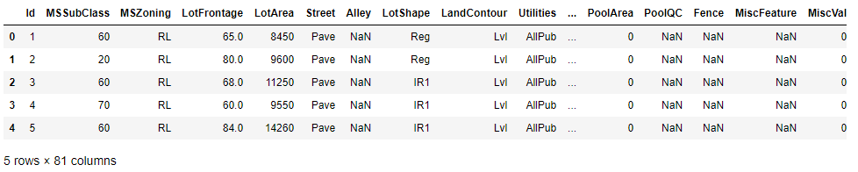
House prices dataset
Source: https://www.kaggle.com/c/house-prices-advanced-regression-techniques
In this project, we will develop and evaluate the performance and the predictive power of a model trained and tested on data collected from houses in Boston’s suburbs.
The dataset has 1460 observations in training set with 79 explanatory variables describing (almost) every aspect of residential homes in Ames
36 numerical features
43 categorical features

Slide 5
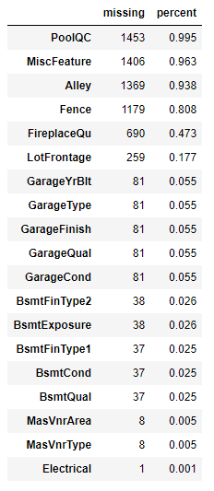
Handling missing values
There are 17 features have missing values:
3 numerical features
14 categorical features
Drop
Strategy:
Drop all features that have over 80% of missing values
Numerical features: filled by mean value
Categorical features: filled by most frequency value

Slide 6
Filled by specific value
# | Feature name | Description | Filled by
1 | Fence | Fence quality | “NF” (No Fence)
2 | Functional | Home functionality (Assume typical unless deductions are warranted) | “Typ” (Typical Functionality)
3 | Electrical | Electrical system | “SBrkr” (Standard Circuit Breakers & Romex)
4 | KitchenQual | Kitchen quality | “TA” (Typical/Average)

Slide 7
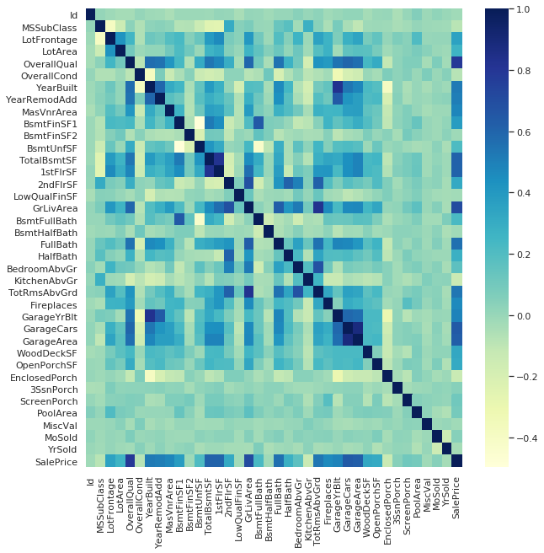
Feature correlation
At first sight, there are some features that have strong correlation:
TotalBsmtSF and 1stFlrSF
GrLivArea and TotRmsAbvGrd
GarageArea and GarageCars
…

Slide 8
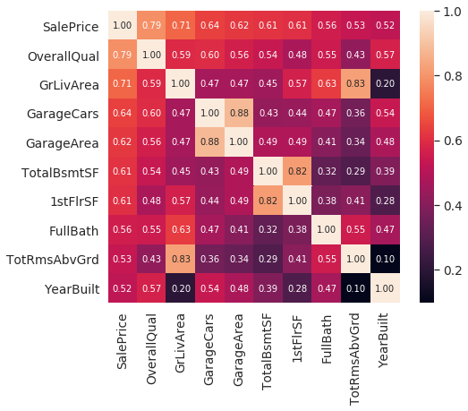
SalePrice correlation matrix
OverallQual, GrLivArea and TotalBsmtSF are strongly correlated with SalePrice.
GarageCars and GarageArea are also some of the most strongly correlated variables.
TotalBsmtSF and 1stFloor also seem to be the same.

Slide 9
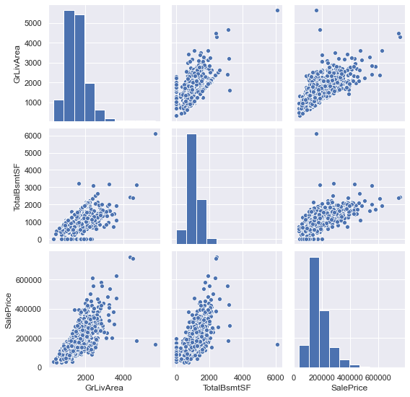
Outliers detection

Slide 10
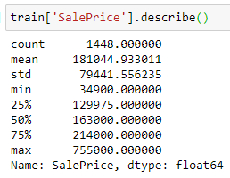

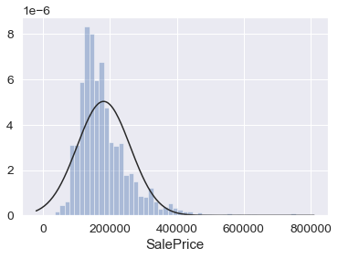
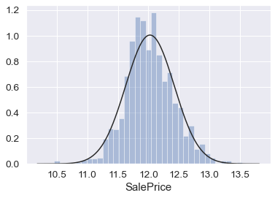
SalePrice
Log transformation

Slide 11
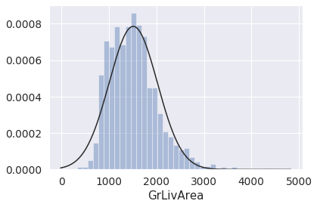
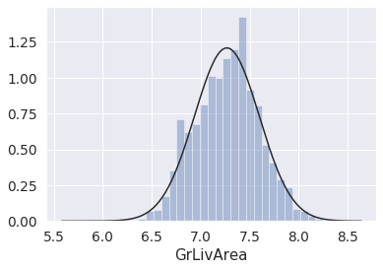
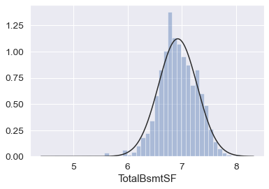
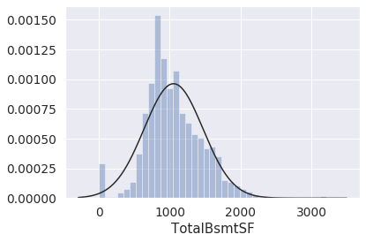
Data Normalization
Log transformation
Log transformation

Slide 12
2. Model Implementation

Slide 13
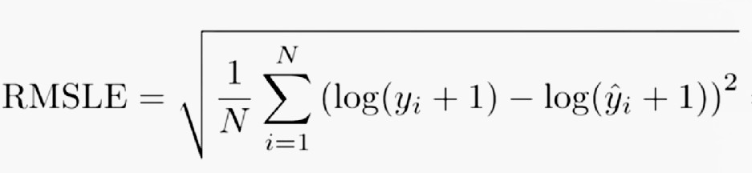
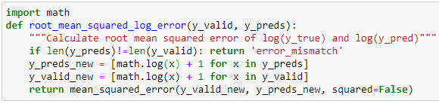
Scoring metric
Model performance are evaluated on Root-Mean-Squared-Error (RMSE) between the logarithm of the predicted value and the logarithm of the observed sales price. (Taking logs means that errors in predicting expensive houses and cheap houses will affect the result equally.)

Slide 14
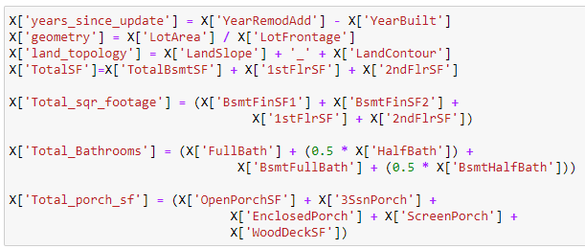
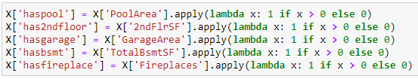
Feature Engineering

Slide 15
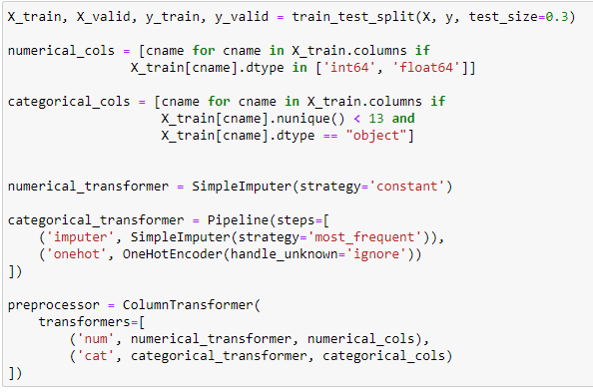
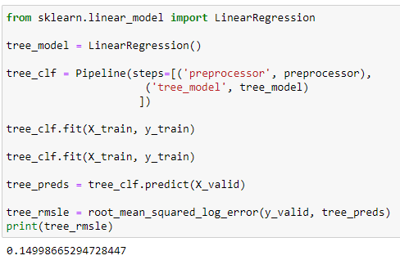
Preprocessing and Baseline model
Linear Regression will be used as Baseline model

Slide 16
Model selection
# | Model | RMSLE
1 | XGBRegressor (after HT) | 0.105633
2 | LightGBM (after HT) | 0.111805
3 | XGBRegressor | 0.115024
4 | LightGBM | 0.125899
5 | Random Forest Regressor | 0.127011
6 | Linear Regression | 0.149987
7 | Decision Tree Regressor | 0.214192
Since XGBoost performed the best, I will use this model for further refinement.

Slide 17
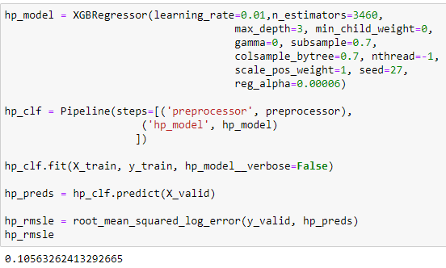
Hyperparameter tuning
Using sklearn’s GridSearchCV to perform hyperparameter optimization. It works by searching exhaustively through a specified subset of hyperparameters.
From GridSearch, I landed on the following model parameters.

Slide 18
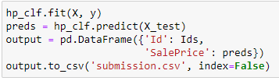
Submission
Predict on test set and create submission.csv file
Submit predictions on Kaggle

Slide 19
Thank you For your Attention

